Slide 1

Project Update
Smithers
Jacob Jones, ECE 551

Slide 2
Outline
Introduction – What’s this all about?
Motivation – Why am I doing this?
Background – Contemporary methods
Proposed Method – What I will be doing
Preliminary Results – What I have done so far
Proposed Research – What still needs to be done
Conclusions – Wrap up this presentation

Slide 3
Introduction
Smithers is a machine learning model used to detect a wake word
This model uses mel-frequency cepstral coefficients and a convolutional neural net to make predictions on real-time audio
This presentation reports on the progress made towards this effort

Slide 4
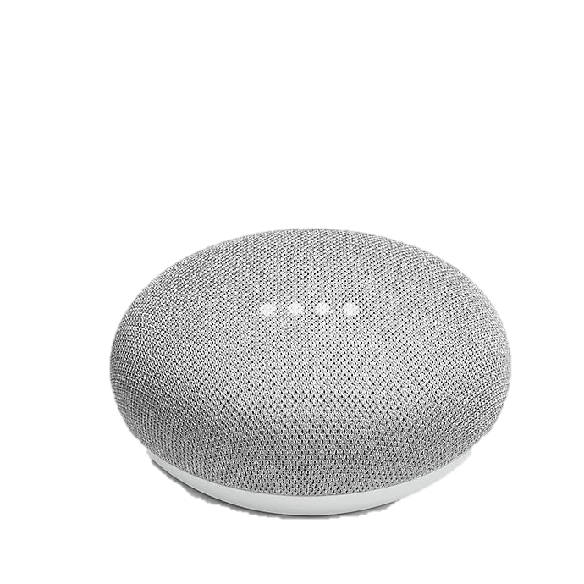

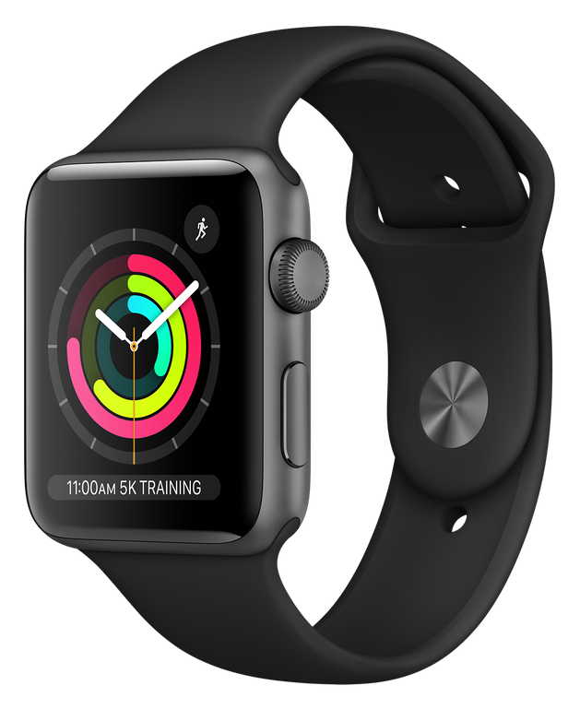
Motivation
Smart devices are everywhere
Smart devices respond to voice commands
Three big ones:
Google Assistant, Alexa, Siri
I am interested in embedded devices
How does voice recognition work on resource-constrained hardware?
Are these devices always listening?
Short answer: No
Long answer: Sort of…

Slide 5
Background
Are these devices always listening?
How do you respond to commands without always listening?
Voice command recognition too computationally intensive
Amazon, Apple, and Google have researched this topic extensively
Common solution: “wake words”
Idea: train model to recognize only one command
“Hey Alexa”, “Hey Siri”, “Hey Google”
Once command is recognized, activate larger model
Some devices place model on separate dedicated processor

Slide 6
Background (cont.)
Common approaches:
Convolutional Neural Nets (CNNs)
Mel-frequency cepstral coefficients (MFCC) – more on these later
Papers referenced:
C. Jose, Y. Mishchenko, T. Senechal, A. Shah, A. Escott, and S. Vitaladevuni, “Accurate detection of wake word start and end using a cnn,” 2020 (Amazon)
G. Chen, C. Parada, and G. Heigold, “Small-footprint keyword spotting using deep neural networks,” in 2014 IEEE International Conference on Acoustics, Speech and Signal Processing (ICASSP), 2014, pp. 4087–4091 (Google)
S. Sigtia, R. Haynes, H. Richards, E. Marchi, and J. Bridle, “Efficient voice trigger detection for low resource hardware,” in INTERSPEECH, 2018 (Apple)

Slide 7
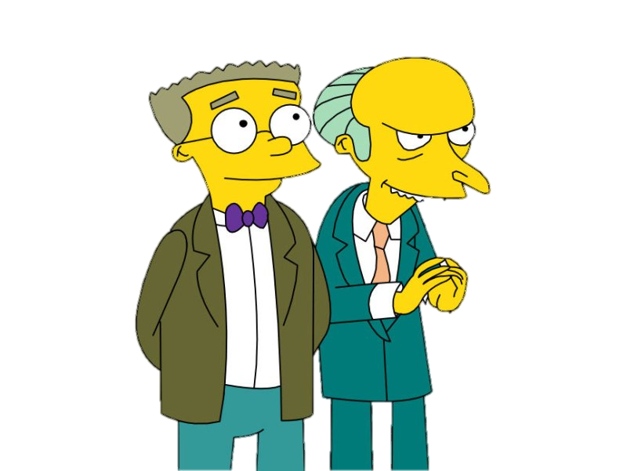
Proposed Method – “Smithers”
Develop my own CNN capable of recognizing the wake word “Smithers”
Why “Smithers”? Smithers is the faithful assistant to the crotchety Mr. Burns in The Simpsons
Use methods proposed by the referenced research paper

Slide 8
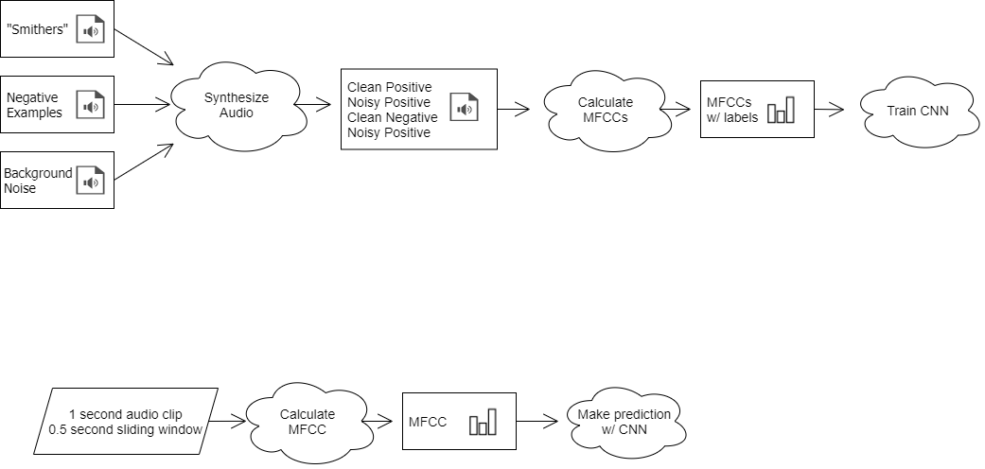
Proposed Method (cont.)
Model Training
Implementation

Slide 9
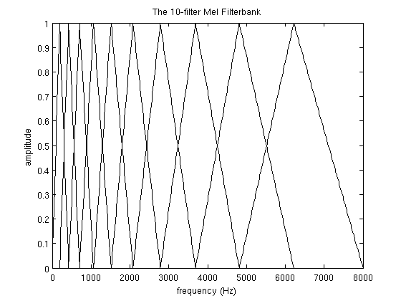
Proposed Method (cont.) - MFCCs
Human ear frequency response is not linear
Mel scale better mimics human hearing
MFCCs – take FFT, apply mel filter bank, take logs of powers at each mel frequency, take discrete cosine transform
MFCCs are amplitudes of spectrum
Idea: distil spectrum into only relevant information
Train CNN with mel-frequency cepstral coefficients (MFCCs)
Source: http://practicalcryptography.com/miscellaneous/machine-learning/guide-mel-frequency-cepstral-coefficients-mfccs/

Slide 10
Proposed Method (cont.) - CNN
Training:
Training audio will be trimmed into 1 second clips – important!
MFCC coefficients will be calculated for each clip
Convolutional neural net will train on the MFCC coefficients
Implementation:
Two 1-second input audio buffers will be used, spaced 0.5 seconds apart
This sliding window will help when trigger word is split between two 1-second intervals

Slide 11
Preliminary Results – Data Synthesis
Recorded 30 examples of the wake word “Smithers”
Used 130 negative examples from Google’s Speech Commands Dataset
Used 200 noise clips from Harvard’s ESC-50 dataset
Synthesized 400 examples each of positive and negative examples
For each loop, choose one positive example, one negative example, and one background noise
Randomly select 1 second interval of noise
Insert each positive example, negative example into random start point of background noise
Save noisy positive, clean positive, noisy negative, and clean negative
Half of dataset is clean, half is noisy

Slide 12
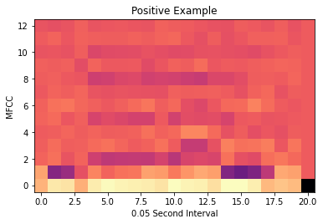
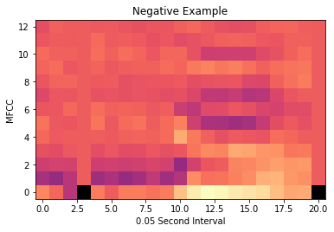
Preliminary Results (cont.) - MFCCs
Audio was downsampled to 10khz
MFCCs were calculated at 0.05 second intervals – 20 total for each 1 second clip

Slide 13
Preliminary Results (cont.) - CNN
Model: "Smithers"
_________________________________________________________________
Layer (type) Output Shape Param #
=================================================================
input_2 (InputLayer) [(None, 13, 21, 1)] 0
_________________________________________________________________
conv2d_3 (Conv2D) (None, 12, 20, 32) 160
_________________________________________________________________
max_pooling2d_3 (MaxPooling2 (None, 6, 10, 32) 0
_________________________________________________________________
conv2d_4 (Conv2D) (None, 5, 9, 32) 4128
_________________________________________________________________
max_pooling2d_4 (MaxPooling2 (None, 3, 5, 32) 0
_________________________________________________________________
conv2d_5 (Conv2D) (None, 2, 4, 64) 8256
_________________________________________________________________
max_pooling2d_5 (MaxPooling2 (None, 1, 2, 64) 0
_________________________________________________________________
flatten_1 (Flatten) (None, 128) 0
_________________________________________________________________
dense_2 (Dense) (None, 64) 8256
_________________________________________________________________
dropout_1 (Dropout) (None, 64) 0
_________________________________________________________________
dense_3 (Dense) (None, 1) 65
=================================================================
Total params: 20,865
Trainable params: 20,865
Non-trainable params: 0
_________________________________________________________________
CNN architecture ripped from the internet
Need to play around with layers
Used RelU activation as suggested by Apple

Slide 14
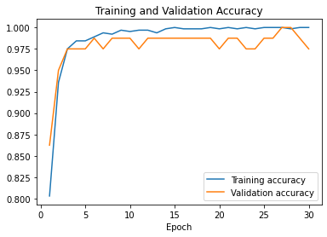
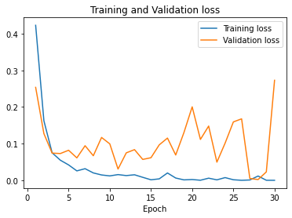
Preliminary Results (cont.) - Validation
Model works!
Works well?

Slide 15
Preliminary Results (cont.) - Discussion
Tested the model on new audio recordings
Model recognized when I said “Smithers”
Key words there: “I said”, not “Smithers”
Model also false-positived on “banana”, “Alexa”, and “dinosaur”
Does model recognize “Smithers” or does model recognize my voice?
Only positive examples came from my voice
Negative examples all came from external datasets
How do you tell model what to look for?

Slide 16
Proposed Research
Record negative example using my voice
Improve example synthesis to better match real audio
Synthesized clips need to be similar to real-time audio
Play around with CNN architecture
Implement real-time predictions
Explore effects of reducing sample rate, quantizing MFCCs
Interested in applying to embedded hardware
How do I quantify the tradeoff on these sacrifices?

Slide 17

Conclusions
Smithers is a machine learning model used to detect a wake word
MFCCs and CNNs are the key components to this model
Current model works, has issues

